Slide 1
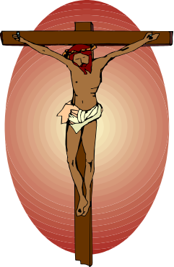


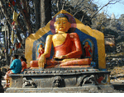
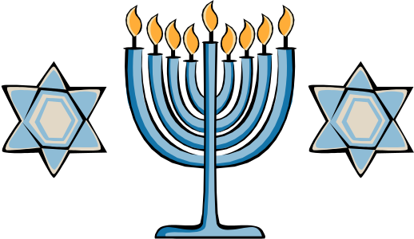
ISLAM AND COMPARATIVE RELIGIONS

Slide 2
SOUTHWEST ASIA
The three divine religions that began in Southwest Asia are:
Judaism (2000 BCE)
Christianity (2000 A.D)
Islam (610 CE)

Slide 3
Buddhism
Buddhism is related to Hinduism and shares many of the same basic beliefs. The relationship between Buddhism and Hinduism is similar to the relationship between Christianity and Judaism.

Slide 4
BUDDHISM
This religion does not explain any socio-economic aspects of human life: it basically relies on the spiritual ecstasy(smoothness).
The literature of this religion is in PALI language and its all in verbal.
Religious Books:
Dhampat
Tri Pitaka

Slide 5
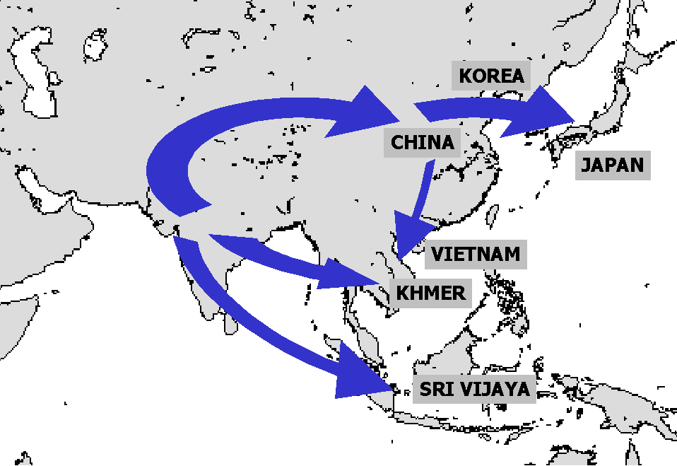
Buddhism

Slide 6

BUDDHISM
In 563 BC, Prince Siddhartha Gautama was born in Nepal.
Grew up wealthy & sheltered.
Never allowed to see pain, death, illness or poverty due to a prophecy.

Slide 7

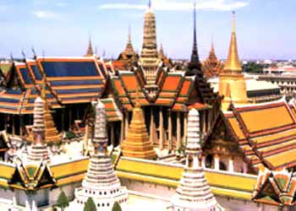
THE PRINCE
Prince leaves palace & realizes the world is full of pain & misery.
Wants to find answer why & how to stop it.
Travels the world & meditates under tree for 49 days.

Slide 8
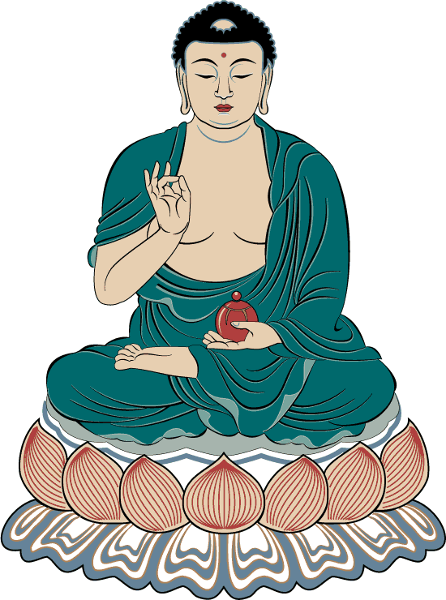
THE BUDDHA
Prince found his answers.
He became known as the Buddha, the “Enlightened One” as he traveled the world to teach his beliefs.

Slide 9
THE FOUR NOBLE TRUTHS
1. Suffering is universal- everyone feels pain.
2. Cause of suffering is desire (riches, objects,).
3. Only way to end suffering, is to crush desire.
4. Way to end desire is to
follow the Noble 8 Fold Paths.

Slide 10
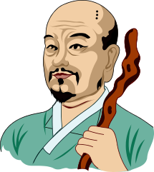
THE NOBLE 8-FOLD PATHS
1.Right Speech (Samma Vaca)
2.Right Action (Samma Kammo)
3.Right Livelihood (Samma Ajivo)
4.Right Exertion or right effort (Samma Vayamo)
5.Right Awareness (Samma Sati)
6.Right Concentration (Samma Samadhi)
7.Right Aspiration/Hope (Samma Sankappo)
8.Right Understanding (Samma ditthi)

Slide 11
BELIEFS
1: no concept of God
2: no concept of Angels and Day of judgement
3: no external power is required for the enlistment of the human being.
IT ALSO PROHIBITS THE FOLLOWING THINGS:
*: to take the life of living things
*: to take possession of anything by fraudulent or forcefully
*: to lie
*: to take such products which can make one addict
*: to perform sinful actions

Slide 12
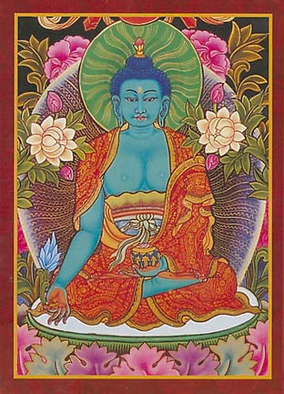
NIRVANA
Goal is to reach NIRVANA- a condition of wanting nothing, a calmness, great insight & happiness.
Two types of Buddhists: one believes Buddha is a teacher, the other believes he is a god.

Slide 13
Religious books
Dhampat
The Tripitaka (Pali Canon),
Mahayana Sutras
The Tibetan Book of the Dead
The Pali Canon, which means “the word of Buddha,” includes some of the Buddha's discourse/speech or writing, but it also incorporates the teachings of his pupils.

Slide 14
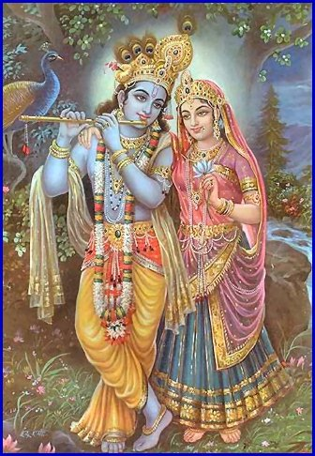
HINDUISM
Oldest major religion. Started somewhere between 2300 B.C. and 1500 B.C.
Group of people called Aryans traveled to Asia, conquered towns & adopted their cultures & religions.

Slide 15
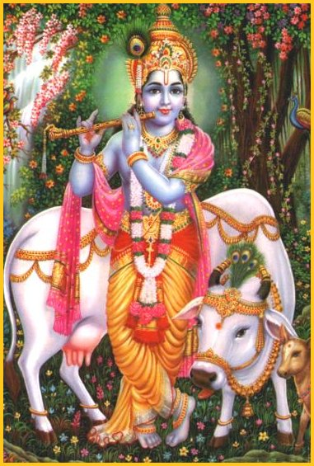
HINDUISM’S BEGINNINGS
Eventually grew into Hinduism.
No single founder.
Worship many gods (polytheistic)
There are many SECTS- that worship one or another gods.

Slide 16


THE BELIEFS
People suffer from pain & sorrow because they chase after false goals such as material goods.
True goal is MOKSHA- free soul from body so soul can join the ATMAN or universal soul.
CANNOT achieve MOKSHA in one lifetime so you need reincarnation.

Slide 17

CYCLE OF REBIRTH
Reincarnation is REBIRTH of the soul in various forms (you keep coming back until you overcome your weaknesses)
KARMA- belief that all good & bad actions, mental or physical, affect people’s fate in their next life.
Present life is result past behavior.

Slide 18
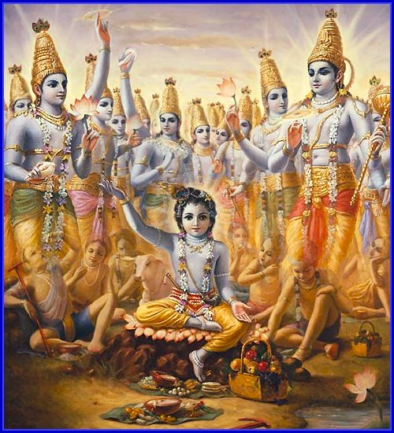
THE BELIEFS
DHARMA- every Hindu has a duty or obligation to their CASTE (social class).
You can improve your position in your next life by fulfilling duties in this life.

Slide 19



THE CASTE SYSTEM
Caste is a strict religious & social order.
You are BORN into a caste or class, & cannot move out of the caste in THIS life.
Your position is a result of karma form previous life.
Very strict rules: Cannot marry or associate with people outside of caste.

Slide 20
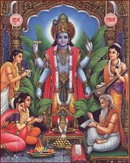
THE CASTES
BRAHMINS:
priest/religious teachings
SHATRIYAS: warriors
VAISH:
landowners & merchants
SHUDARS:
servants,
peasants &
Untouchables

Slide 21
SACRED HINDU BOOKS.
Basically Hindu religion is based on the concept of Waidh, which means knowledge or science. “Waidh is not the name of a special book” says Dr. Surindharnath Das Gupta ,who is a principal at the Sanscresal College Calcutta.
According to him “ Waidh is the compilation of the 2000 years old collective experiences and studies shared by the different sects of people who came from different places and directions of Hindustan”. hence following are the names of the different books of Hinduism”

Slide 22
BOOKS.
WAIDH: 2000 year old shared experiences of different Hindus. this book is further divided in four waidhs:
1.Rig Waidh 2.Sam Waidh 3.Yajar Waidh 4.Ather Waidh.
UPANISHAND: strong directions regarding Gayan and Meditation( muraqba)
3. RAMYAN(1000 B.C) AND MAHABHARAT: written in 1200 B.C, based on the religious education
4. GEETA: A compilation of Shiree Krishen Maharaj’s directives.

Slide 23
SACRED STATUES OF HINDUISM
Hindus basically worship thousands of statues in the temple, but three of these are given more superiority than others:
Trimoorti
BHARHMA: He created every thing in the world but as the world came into being it was of no use.
WISHNU: He has the power of controlling the human life.
SHIVA : He takes away the human lives.

Slide 24
JUDAISM (ZOINISM)
INTRODUCTION: Judaism includes the people who call themselves Bani Israel ( sons of Israel). and it was the title of Yaqoob A.S.
Saturday is their holiday called ( Yom-us-Sbt).
They are always busy in hatching conspiracies.
They claim that they are the chosen one from God. They consider themselves to be the pure and superior of all other religions and nations.

Slide 25
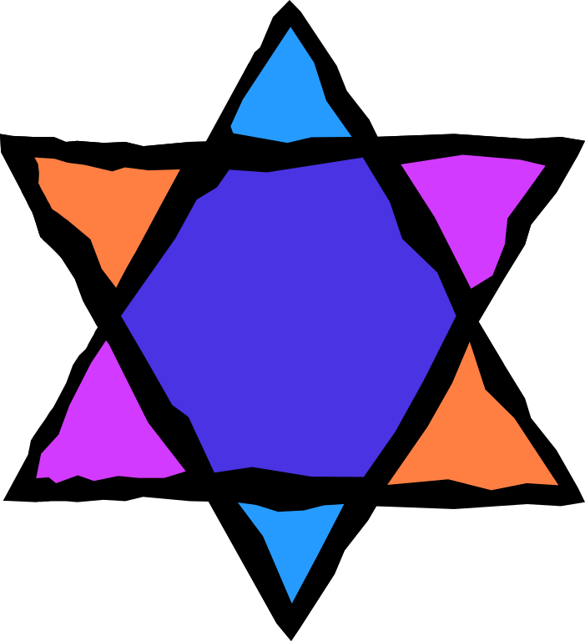
JUDAISM
Among world’s oldest religions.
Nomads established the kingdom of Israel in 1047 BC.

Slide 26

Jews exiled from Palestine, returned & exiled again when the Romans took over.
Many Jews began to return to Israel in the 1900s & Israel becomes a Jewish nation in 1948.

Slide 27

MOSES
Moses was the prophet of Bani Israel.
He introduced the 10 Commandments.
Which also became part of Christianity.

Slide 28


TEACHINGS OF JUDAISM
Jews God’s chosen people.
Must obey God & all of His laws.
People are responsible for their own actions.
No one can love God without loving his neighbor.

Slide 29

Govts are not as good as they could be so there will be a kingdom of God on Earth.

Slide 30
BOOKS OF JUDAISM
The Old Testament (also known as the Jewish Tanakh) is the first 39 books in most Christian Bibles( genesis, exodus, Leviticus etc)
oLD TESTAMENT: It comprises of Taurat and Zabur.

Slide 31
CHRISTAINITY
This religion is based on the teachings of Hazrat Esa (Jesus Christ)
The believers of the religion are called Christian.
Jesus Christ was given birth throw the body of Bibi Maryam ( the Marry).
Jesus Christ came in this world at 4 B.C and was carried away in the skies at 29th A.D.
This religion is based on the concept of Trinity.

Slide 32
BELIEFS
Christianity was heavily influenced by Judaism. Some of the major beliefs of Christianity are:
Trinity, in Christian doctrine, the unity of Father, Son, and Holy Spirit as three persons in one Godhead.
Jesus Christ died for the sins of humankind.
Salvation comes from faith in God.

Slide 33
Christianity
Some branches of Christianity are:
Roman Catholicism: the largest Christian church
Eastern Orthodox: the second-largest Christian church
Protestantism

Slide 34

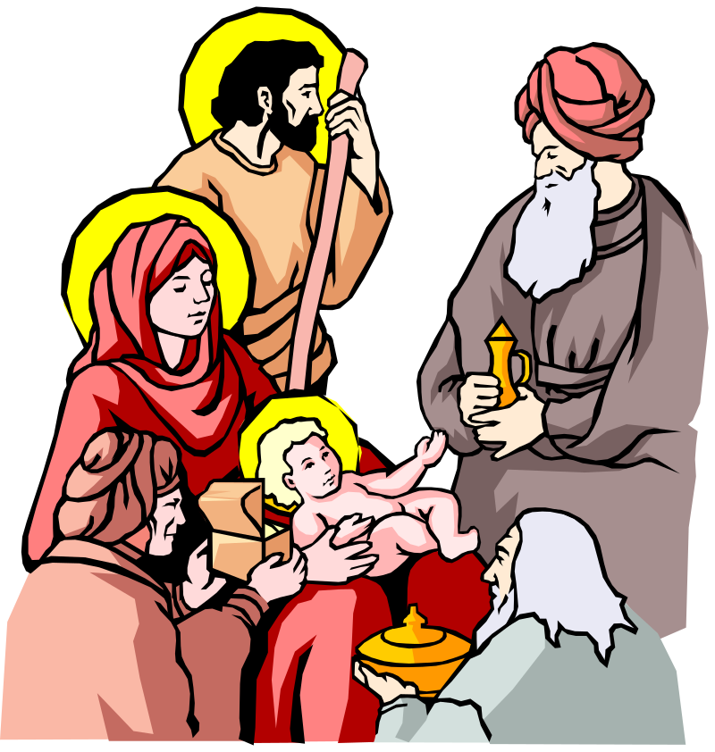
CHRISTIANITY
Began in Palestine.
Story is in Gospels of the Bible.
Jesus born in Bethlehem.
Worked as a carpenter & studied under Rabbis.

Slide 35
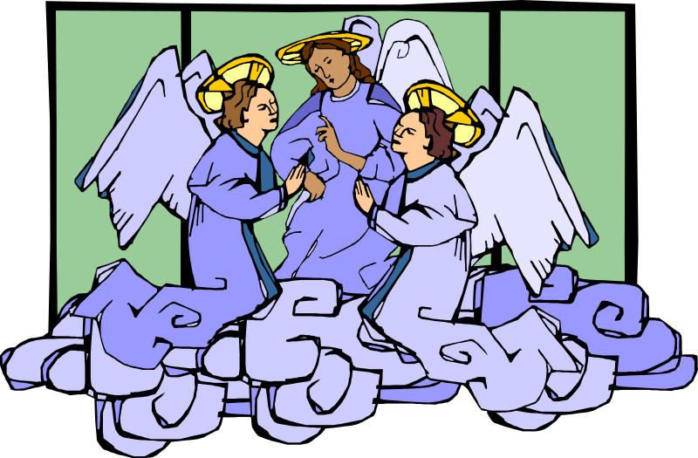
CHRISTIANITY
At 30, became a preacher, teaching about God’s goodness & attracting many followers.
Jewish prophets had predicted a messiah would save the Jews form foreign rule.

Slide 36
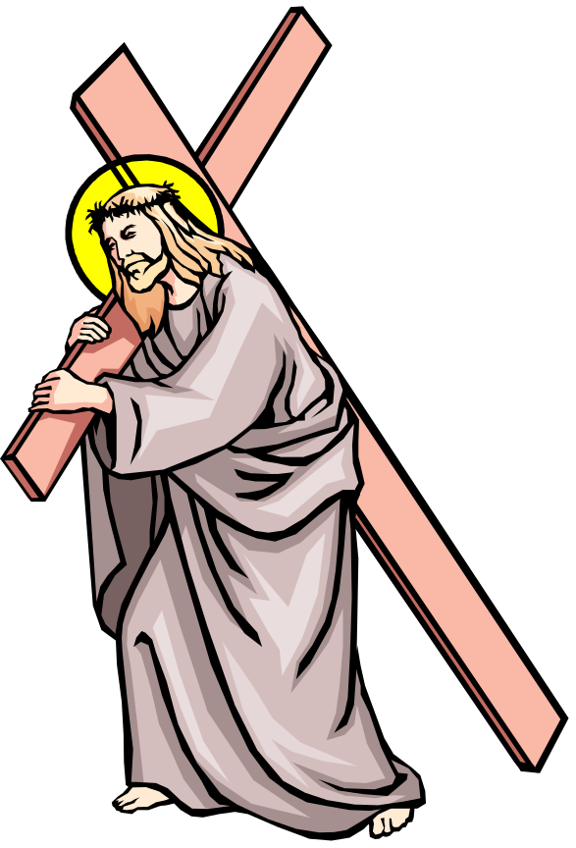
CHRISTIANITY
Jewish & Roman leaders saw him as a troublemaker when he refused to recognize Roman leaders as gods.
Executed at 33.

Slide 37

TEACHINGS OF CHRISTIANITY
Believe in one God who is loving and forgiving.
Be compassionate to others
All are equal & loved by God.
Will be rewarded for belief with eternal life.
Follow the teachings of Christ & the Bible.
Belief that Jesus is the son of God.

Slide 38
HOLY BOOKS OF CHRISTIANITY
Christians believe the Old and New Testaments of the Bible. The first four books of the New Testament were written by followers of Jesus.
New testament of BIBLE is further divided in the following books:
MATTI
LUQUS
MARQAS
YOHANNA

